Slide 1

Welcome to
Year 5

Slide 2
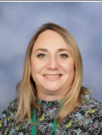
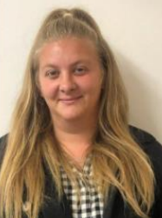
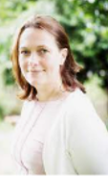
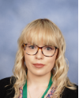

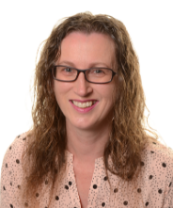
Year 5 team
Mrs Sheargold-Jones and Miss Bell - 5S
Mrs Connor and Miss Perrin – 5C
Year group lead
Mr Doran, Mrs Puplett and Miss Sandra – 5D

Slide 3
Key Dates
Tuesday 29th September
School photos
Tuesday 13th and Thursday 15th October
Parents’ evenings
Friday 20th November
Children in Need
Week Beginning 23rd November
Assessment Week
Wednesday 16th December
Christmas lunch
Christmas Performance – 14th and 15th December (prospective dates)
Samba Day – date TBC (Summer Term)
Mercers Lake – date TBC (Summer Term)

Slide 4
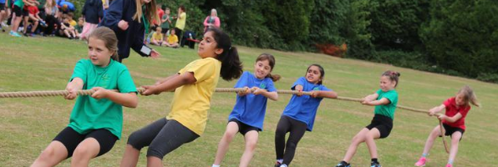
Organisation & Independence
As always, the children need to be ‘Ready to Learn’ when they arrive at school in the morning. They need to remember their:
Pencil case with equipment including whiteboard pen, glue and scissors;
Reading book;
Reading record book;
Water bottle;
Completed home learning such as spellings on a Friday.
They should come into school in their P.E kits. Please make sure all belongings are named.
Our PE days are currently –
5C – Tuesday & Wednesday
5D – Tuesday & Friday
5S – Monday & Friday
Uniform needs to be labelled, worn correctly and long hair should be tied back. Only stud earrings can be worn on non-PE days. Earrings should be taken out on these days or replaced with plastic retainers.

Slide 5

Reading Books & Reading Record Book
The children have independent choice for their reading book. We ask that children keep a record of their reading in their Reading Record books. We like children to read 5 times a week for 20 minutes.
We will check and sign the reading record books once a week and ask that parents do the same.
Please feel free to send any messages via the reading record book. It is the children’s responsibility to make their teachers aware of any notes from home as we do not look at them every day.
Please take the time to read through the information in the reading record books. It contains a lot of useful information, such as: spelling lists, top tips for learning, French phrases, times tables and world map (to name just a few!).
There is also a space for the children to write down their weekly TTRS and spelling scores.

Slide 6

100 books to read before you leave Yattendon
Inside every child’s Home Reading Record Book is a list of our “100 books to read before you leave Yattendon” initiative.
On our school website we also have a parents/carers’ guide to each of our recommended books.
*our guide is to support parents when deciding if a book is appropriate for your child. Please consider that age recommendations may vary from child to child.

Slide 7
Our Topics
Autumn 1
Jet into Year 5 – The Maya, Gatwick
Autumn 2
Jet into Year 5 – Forces, Local physical and human geography
Spring 1
Earth and Beyond – Space
Spring 2
Earth and Beyond - Earth, Tropics and Time Zones. DT – Moving Toys
Summer 1
The Circle of Life – Life Cycles, Human Life Cycles
Summer 2
Hasta Luego Year 5 – North and South America, Materials

Slide 8
Home Learning
Daily reading with an adult for 20 minutes (5 x per week).
Completing a set number of Times Tables Rock Stars sessions - Logins will stay the same and the App can be accessed through ‘Google Play’ or the ‘App Store’. You can also access Times Tables Rock Stars through your web browser. 15 minutes every week.
Spellings - Children will be set spellings weekly and should practise these on one page of their spelling book. They will be tested on their spellings on a Friday.
Termly Homework – The children will be given a home learning grid with a number of different activities across a range of different topics. Children can choose which activities they want to complete and how they will evidence what they have done. Children will bring in their completed homework journals for the term to the home learning celebration in the last week of term.

Slide 9
Communication
At Yattendon, we strive to build a strong teacher-parent relationship. Despite the challenges that we currently face, we welcome any parents that would like to come and support children in the classroom or listen to readers. Please use the class email addresses to let us know if you would like to help.
Mrs Connor – class5c@yattendon.surrey.sch.uk
Mrs Sheargold-Jones - class5s@yattendon.surrey.sch.uk
Mr Doran – class5d@yattendon.surrey.sch.uk
If you have any concerns please do not hesitate to contact us. If you need an appointment to see us, please speak to the office or put a note in the Reading Record Book – please ask your child to flag these to us.
If you cannot get into school, please contact us via a letter, Arbor or again write a note in your child’s Reading Record Book.

Slide 10
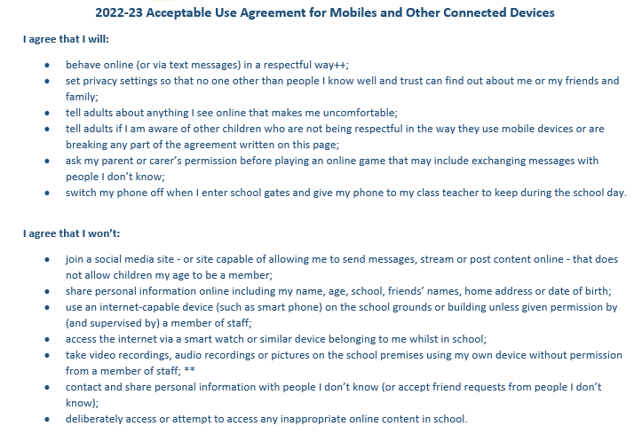
Mobile Phone Agreement

Slide 11
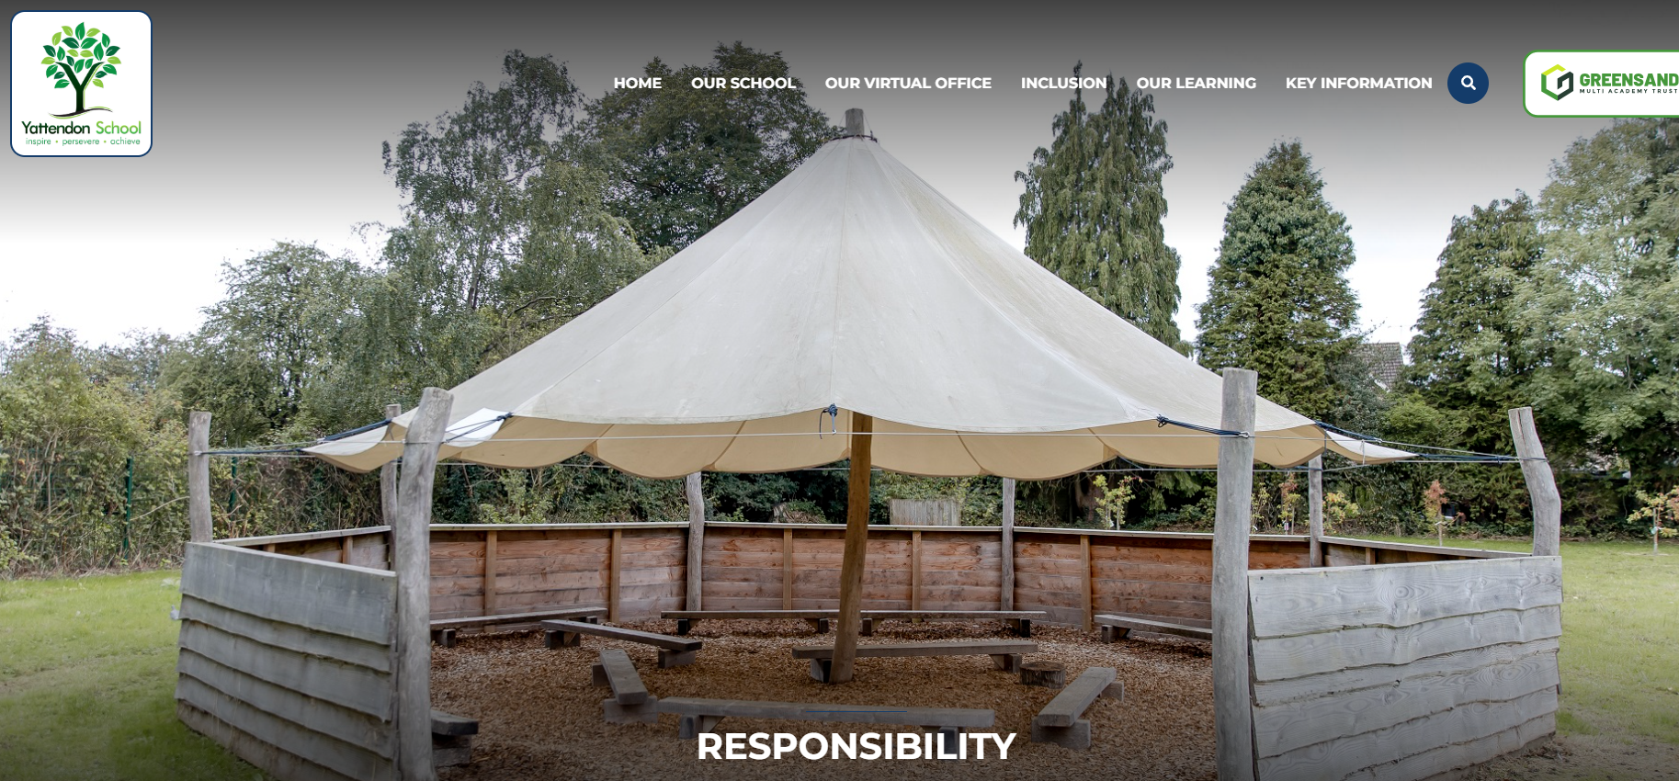
www.yattendon.org

